Slide 1

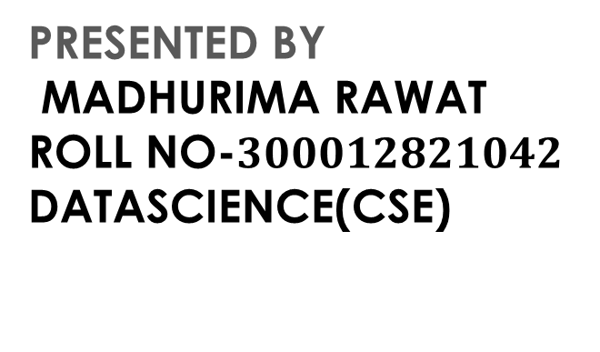
PROBLEM SOLVING STRATEGY
BACKTRACKING
PRESENTED BY MADHURIMA RAWAT ROLL NO-$300012821042$ DATASCIENCE(CSE)
CHHATTISGARH SWAMI VIVEKANANDA TECHNICAL
UNIVERSITY

Slide 2
WHAT IS BACKTRACKING?
Backtracking is a technique based on algorithm to solve problem. It uses recursive calling to find the solution by building a solution step by step increasing values with time. It removes the solutions that doesn't give rise to the solution of the problem based on the constraints given to solve the problem.
Backtracking algorithm is applied to some specific types of problems,
Decision problem used to find a feasible solution of the problem.
Optimisation problem used to find the best solution that can be applied.
Enumeration problem used to find the set of all feasible solutions of the problem.

Slide 3
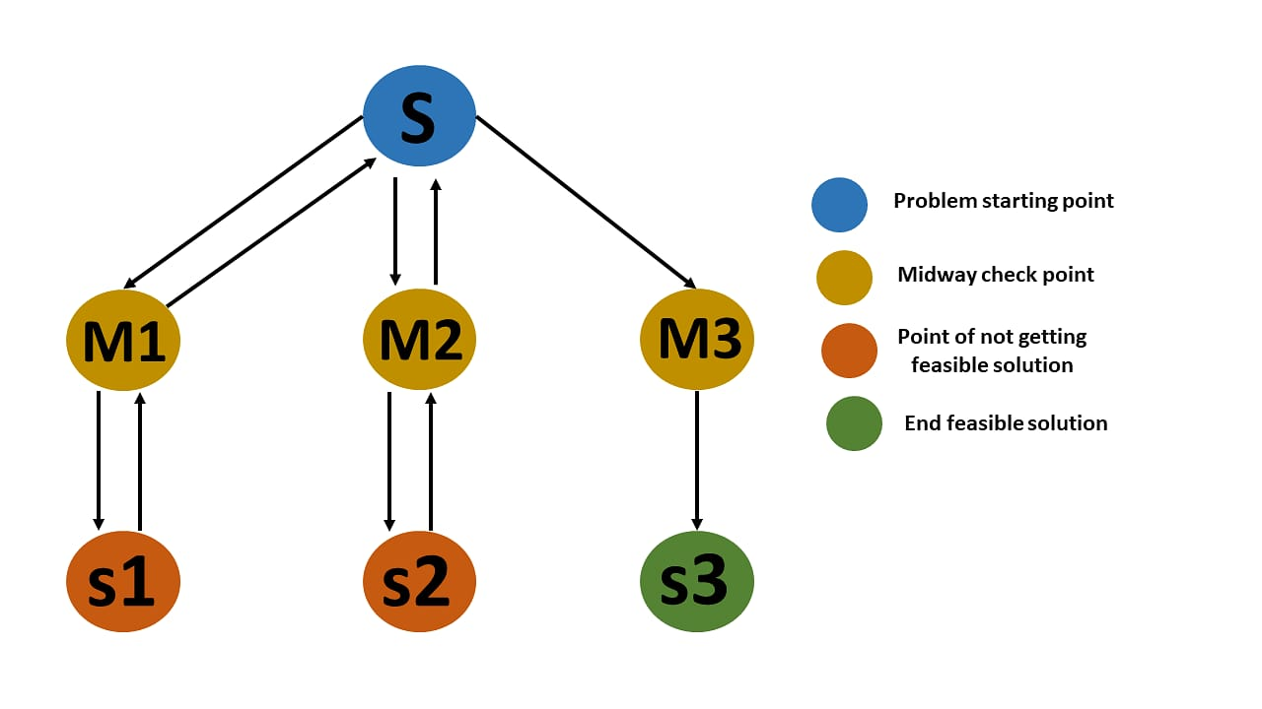
EXAMPLE OF BACKTRACKING
In backtracking problem, the algorithm tries to find a sequence path to the solution which has some small checkpoints from where the problem can backtrack if no feasible solution is found for the problem.
Here, when the algorithm
propagates to an end to check
if it is a solution or not,
if it is then returns the solution
otherwise
backtracks to the point one step
behind it to find track to the next
point to find solution.

Slide 4
ALGORITHM
Step 1 − If current_position is goal, return success
Step 2 − Else
Step 3 − If current_position is an end point, return failed.
Step 4 − Else, if current_position is not end point, explore and repeat above steps.

Slide 5
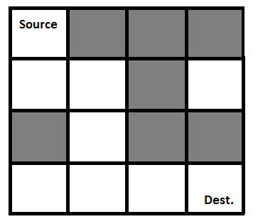
RAT IN A MAZE BACKTRACKING APPLICATION PROBLEM
Constraints:
A Maze is given as N*N binary matrix of blocks
where source block is the upper left most block
i.e., maze[0][0] and destination block is lower
rightmost block i.e., maze[N-1][N-1].
A rat starts from source and has to reach the
destination. The rat can move only in two directions: forward and down.
In the maze matrix, 0 means the block is a dead end and 1 means the block can be
used in the path from source to destination.
Gray blocks are dead ends (value = 0).

Slide 6
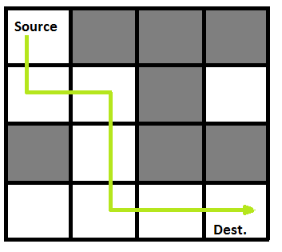
REPRESENTATION IN BINARY FORM
{1
Following is a binary matrix representation of the above maze.
{1, 0, 0, 0}
{1, 1, 0, 1}
{0, 1, 0, 0}
{1, 1, 1, 1}
Following is the solution matrix (output of
program) for the above input matrix.
{1, 0, 0, 0}
{1, 1, 0, 0}
{0, 1, 0, 0}
{0, 1, 1, 1}
All entries in solution path are marked as 1.

Slide 7
SOLUTION ANALYSIS
Approach: Form a recursive function, which will follow a path and check if the path reaches the destination or not. If the path does not reach the destination then backtrack and try other paths.
Algorithm:
Create a solution matrix, initially filled with 0’s.
Create a recursive function, which takes initial matrix, output matrix and position of rat (i, j).
if the position is out of the matrix or the position is not valid then return.
Mark the position output[i][j] as 1 and check if the current position is destination or not. If destination is reached print the output matrix and return.
Recursively call for position (i+1, j) and (i, j+1).
Unmark position (i, j), i.e output[i][j] = 0.

Slide 8
CODE IN C FOR IMPLEMENTATION
#include <stdio.h>
#include<stdbool.h>
// Maze size
#define N 4
bool solveMazeUtil(int maze[N][N], int x, int y,int sol[N][N]);
void printSolution(int sol[N][N]){
for (int i = 0; i < N; i++) {
for (int j = 0; j < N; j++)
printf(" %d ", sol[i][j]);
printf("\n"); }}
// A utility function to check if x, y is valid index for N*N maze
bool isSafe(int maze[N][N], int x, int y){
// if (x, y outside maze) return false
if (x >= 0 && x < N && y >= 0 && y < N && maze[x][y] == 1)
return true;
return false;}
bool solveMaze(int maze[N][N]){
int sol[N][N] = { { 0, 0, 0, 0 },
{ 0, 0, 0, 0 },
{ 0, 0, 0, 0 },
{ 0, 0, 0, 0 } };
if (solveMazeUtil(maze, 0, 0, sol) == false) {
printf("Solution doesn't exist");
return false;}
printSolution(sol);
return true;}
bool solveMazeUtil(int maze[N][N], int x, int y,
int sol[N][N]){
// if (x, y is goal) return true
if (x == N - 1 && y == N - 1 && maze[x][y] == 1) {
sol[x][y] = 1;
return true; }
// Check if maze[x][y] is valid
if (isSafe(maze, x, y) == true) {
// Check if the current block is already part of
// solution path.
if (sol[x][y] == 1) return false;

Slide 9
CONTINUATION
// mark x, y as part of solution path
sol[x][y] = 1;
/* Move forward in x direction */
if (solveMazeUtil(maze, x + 1, y, sol) == true)
return true;
// If moving in x direction doesn't give solution
// then Move down in y direction
if (solveMazeUtil(maze, x,
y + 1, sol) == true)
return true;
// BACKTRACK: unmark x, y as part of solution path
sol[x][y] = 0;
return false;}
return false;}
// driver program to test above function
int main(){
int maze[N][N] = { { 1, 0, 0, 0 },
{ 1, 1, 0, 1 },
{ 0, 1, 0, 0 },
{ 1, 1, 1, 1 } };
solveMaze(maze);
return 0;}

Slide 10
OUTPUT:
The 1 values show the path for rat
Complexity Analysis:
Time Complexity: O(2^(n^2)). The recursion can run upper-bound 2^(n^2) times.
Space Complexity: O(n^2). Output matrix is required so an extra space of size n*n is needed.
1 0 0 0
1 1 0 0
1 0 0 0
0 1 1 1

Slide 11
THANK YOU FOR LISTENING TO ME
ANY QUESTIONS

